Slide 1
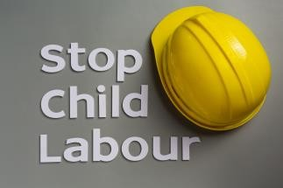




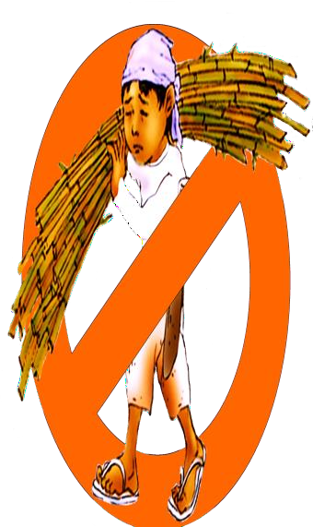








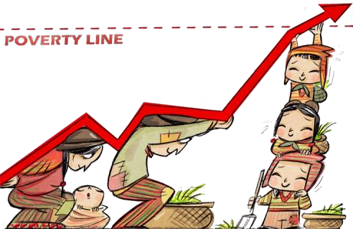
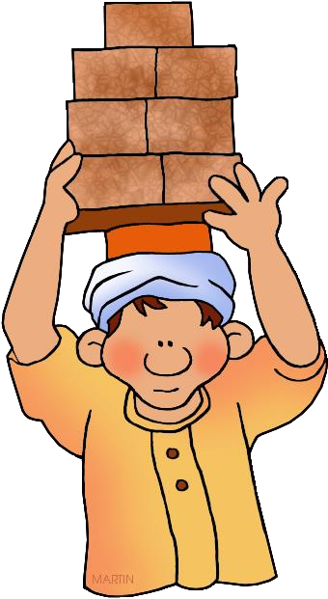
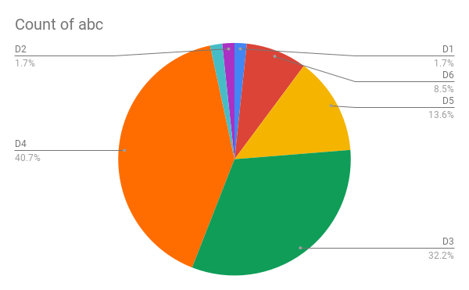



CHILD LABOR IN INDIA
Introduction:
Child labor is term which mean any work perform by the child for earning money. Child labor is violation of human rights. Many children have it negative impact on physical health as well as mental health. According to the India Act,2016 state that children below the age of 14 are not allowed to work as a child labor.
Finding 1:
90% of children in India are working in mining industry where they are exposed of dust, gas and fumes. 70% of children reported exposure to loud noise and effected by the temperature. 69% of children are working to carry heavy loads at work. According to data, The number of child laborers in India is 10.10 million of which 5.60 million are boys and 4.50 million are girls.
Causes of Child labor:
Finding 2:
Increase in population Poverty
Increase in families Low illiteracy rate. Unemployment
Lack of compulsory education
Child labors increase the vulnerability to exploitation
and abuse. Violation of right
to education. illness. Increase
Increase
food
insecurity and malnutrition.
Effect of Child labor:
Premature ageing. Malnutrition Depression and stress. Drug addiction.
Conclusion:
To stop the child labor, it is necessary to spread awareness among the people to take responsibility of reporting about anyone if some hire the child below the age of 14 years. Compulsory education is required to reduce the child labor. The child labor policies and education policies have been formulated and operated in society. Indian Government effort is necessary to eliminate the creation of child labor in society.
References:
Prashad, L., Dutta, M. and Dash, B.M., 2021. Spatial analysis of child labour in India. Journal of Children's Services.
Trinh, T.A., 2020. Mental health impacts of child labour: evidence from Vietnam and India. The Journal of Development Studies, 56(12), pp.2251-2265.
Das, K.S., 2022. Child Labour and its Determinants in India. Children and Youth Services Review, p.106523.
Rather, A., CHILD LABOUR IN INDIA: DECONSTRUCTING THE CHALLENGES.

